Slide 1
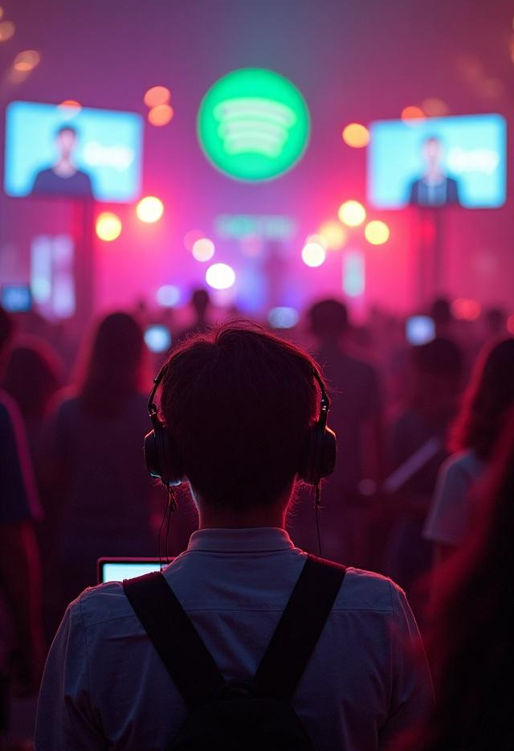
Most Streamed Songs
A Comprehensive Analysis of Spotify's Streaming Trends and Insights
MALINI K
20XX
00/00

Slide 2
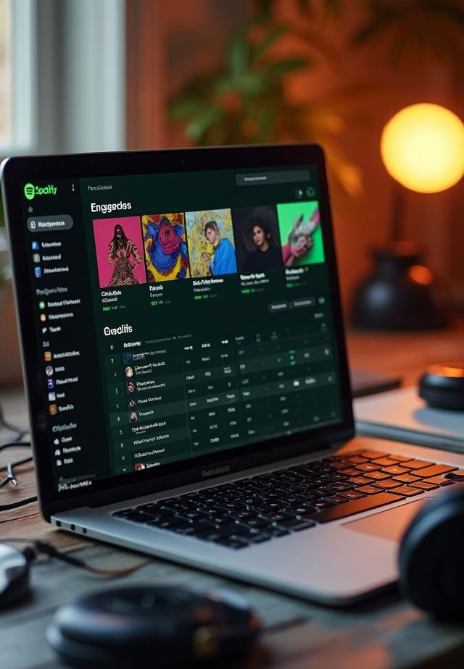
Introduction
This presentation explores the data behind Spotify's most streamed songs, analyzing the trends, popular genres, and the factors that drive streaming success.

Slide 3

Overview of streaming growth
The growth of music streaming has accelerated significantly over the past decade. Spotify, as a leading platform, accounts for a major share of this increase. The user base has expanded, with millions of subscribers contributing to vast amounts of streamed content. This slide delves into the statistics demonstrating streaming growth in terms of user acquisition and song plays.

Slide 4
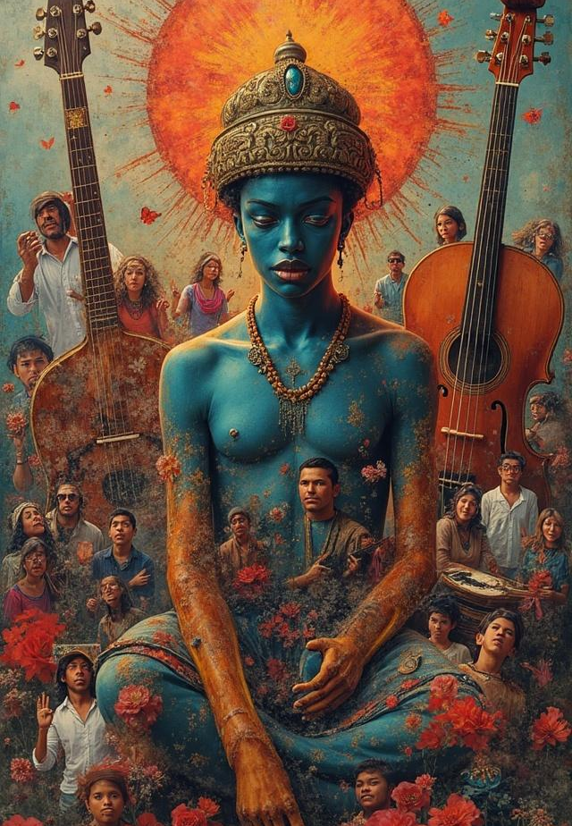
Popular genres and their impact
Various genres have different levels of popularity on Spotify. This slide examines which musical styles dominate the charts, how cultural trends influence these preferences, and their impact on the overall streaming market. Additionally, we'll analyze how genre evolution affects listener engagement and song performance.

Slide 5

Songs with the highest streams
This section focuses on the songs that have achieved the highest streaming numbers on Spotify. It discusses the specific tracks that reached iconic status, detailing their total streams, release dates, and artists. The analysis includes insights on how these songs performed over time and their significance in the music industry.

Slide 6

Factors contributing to popularity
Several factors contribute to a song's success on Spotify. This slide explores elements such as marketing strategies, social media influence, collaborations, and trends in music production. We will also look into how playlists, algorithms, and user-generated content play a role in promoting songs, ultimately leading to increased streams.

Slide 7

Comparison of weekly trends
Analyzing weekly trends provides a dynamic view of how songs perform over time. This slide presents data comparing streaming numbers on a weekly basis, highlighting spikes during certain events such as award shows, viral trends, or artist promotions. Understanding these fluctuations can help in predicting future song performance and listener engagement patterns.

Slide 8
Future Enhancement
Future enhancements for most streamed Spotify songs could include AI-driven content discovery, personalized video recommendations, and integration of short-form video content. Additionally, features like Spotify Countdown Pages, music videos, and save songs from Instagram to Spotify could also be developed. Blockchain technology and immersive audio experiences are also potential future enhancements

Slide 9

Conclusions
In summary, this presentation has investigated the intricate details surrounding Spotify's most streamed songs. We've examined listener demographics, analyzed top songs, identified popularity factors, and evaluated weekly streaming trends. These insights are crucial for artists, marketers, and industry stakeholders aiming to achieve success in the evolving landscape of music streaming.

Slide 10
THANK YOU

